Slide 1

Long Island Sound Water Quality Monitoring Program
2025 Hypoxia Season Quick Facts
Cruise | Start Date | End Date | Number of Stations Sampled | Number of Hypoxic Stations | Hypoxic Area (mi2) | Minimum DO (mg/L) | Station where Minimum DO Occurred
WQJUN25 | 6/2/2025 | 6/4/2025 | 17 | 0 | 0 | 7.46 | A4
HYJUN25 | 6/17/2025 | 6/18/2025 | 30 | 0 | 0 | 6.54 | E1
IEC RUN #1 | 6/24/2025 | 6/24/2025 | 23 | 0 | NC | 3.65 | 8-403
WQJUL25 | 6/30/2025 | 7/2/2025 | 40 | 0 | 0 | 4.5 | A4
IEC RUN #2 | 7/1/2025 | 7/1/2025 | 24 | 0 | NC | 3.33 | 9-413
IEC RUN #3 | 7/8/2025 | 7/8/2025 | 24 | 4 | NC | 0.95 | 9-413
HYJUL25 | 7/14/2025 | 7/16/2025 | 39 | 1 | 18.07 | 2.85 | A4
IEC RUN #4 | 7/18/2025 | 7/18/2025 | 24 | 5 | NC | 2.52 | H-C1
IEC RUN #5 | 7/24/2025 | 7/24/2025 | 24 | 2 | NC | 2.35 | A5
IEC RUN #6 | 7/29/2025 | 7/29/2025 | 24 | 6 | NC | 2.38 | H-C1
WQAUG25 | 7/29/2025 | 7/31/2025 | 37 | 1 | 18.34 | 2.47 | A4
IEC RUN #7 | 8/5/2025 | 8/5/2025 | 24 | 8 | NC | 2.5 | A3
IEC RUN #8 | 8/12/2025 | 8/12/2025 | 24 | 3 | NC | 2.43 | B3M
HYAUG25 | 8/11/2025 | 8/13/2025 | 39 | 0 | 0 | 3.05 | B3M
IEC RUN #9 | 8/19/2025 | 8/19/2025 | 24 | 1* | NC | 1.91 | A3
IEC RUN #10 | 8/26/2025 | 8/26/2025 | 24 | 0 | NC | 4.34 | H-B
WQSEP25 | 8/25/2025 | 8/28/2025 | 40 | 0 | 0 | 4.6 | A4
IEC RUN #11 | 9/2/2025 | 9/2/2025 | 24 | 0 | 0 | 3.3 | H-B
HYSEP25 | No Survey Conducted DO>3.0 mg/L
IEC RUN #12 | 9/9/2025 | 9/9/2025 | 24 | 0 | NC | 3.57 | H-B
 | * YSI cable broke, No Data available from 11 stations

Slide 2
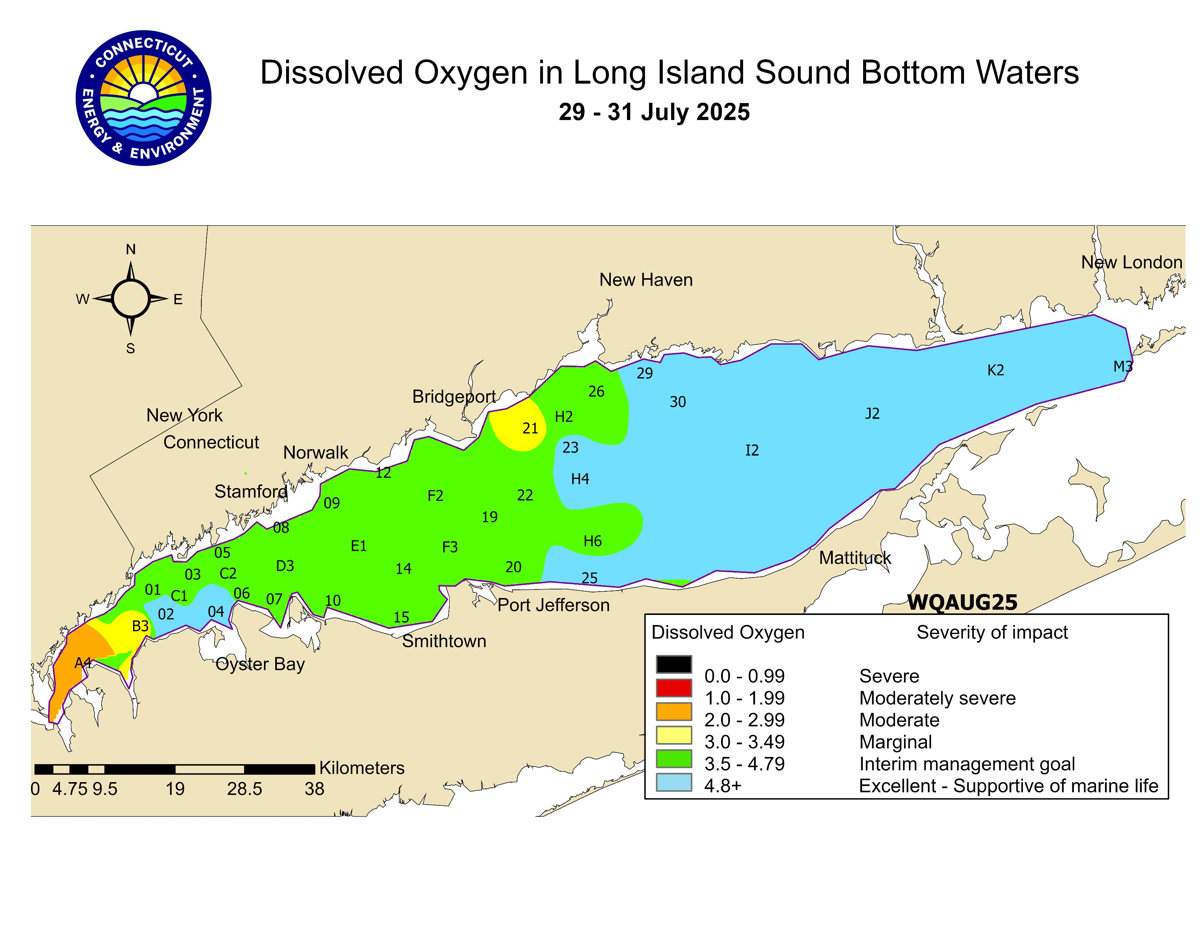
Long Island Sound Water Quality Monitoring Program
2025 Hypoxia Season Quick Facts
CTDEEP Data
6/2/25-8/28/25
Date of onset- 7/14/25
End date- 8/22/25
Duration: 40 days total
Maximum Area:
47.5 km² (18.34 mi²) during WQAUG24 survey (7/29-31/25)

Slide 3
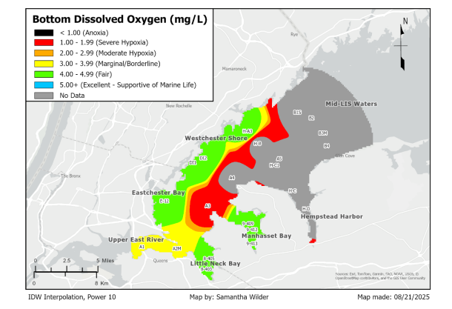

Long Island Sound Water Quality Monitoring Program
2025 Hypoxia Season Quick Facts
IEC Data:
Minimum Dissolved Oxygen Concentration Observed during IEC cruises: 0.95 mg/L at Station 9-413 (Manhasset Bay) during Run #3 conducted 7/8/24
IEC Run #9 August 19, 2025

Slide 4
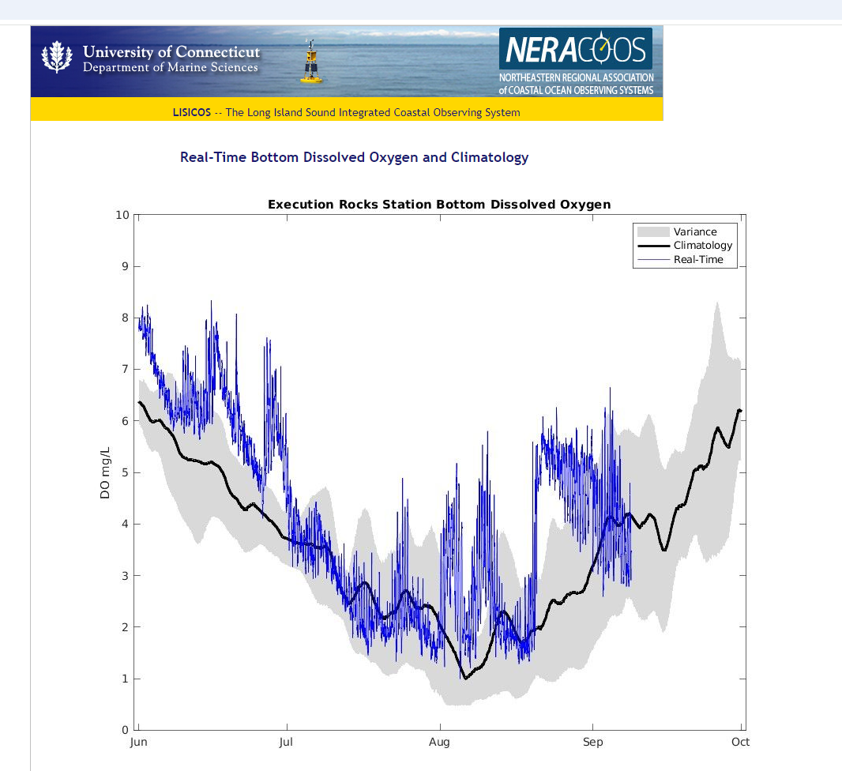
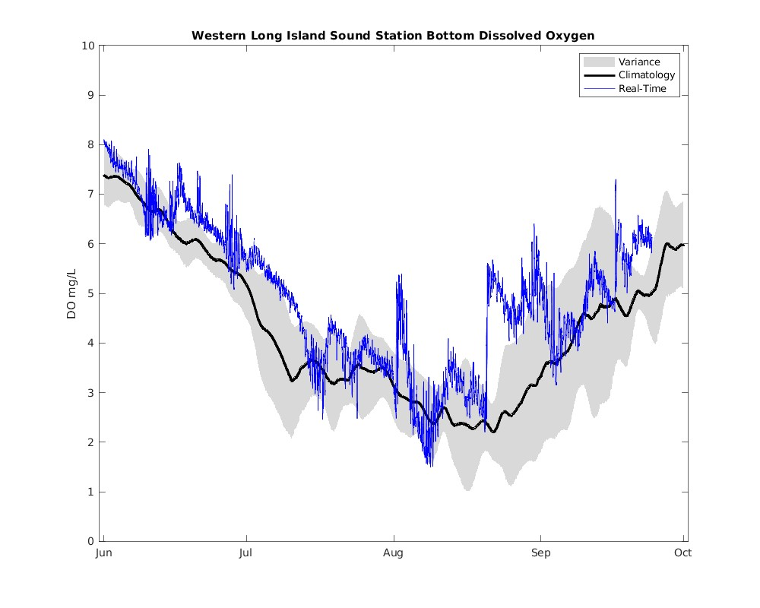
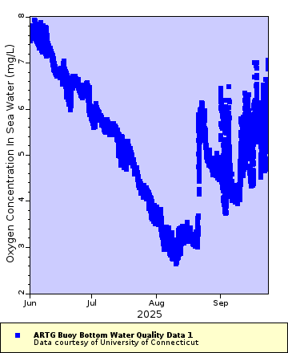
Long Island Sound Water Quality Monitoring Program
2025 Hypoxia Season Quick Facts
LISICOS Data – Execution Rocks
6/1/25-9/24/25
34.27 days <3.0 mg/L
15.83 days < 2.0 mg/L
0.01 days < 1.0 mg/L
Minimum DO: 1.00 mg/L on 8/5/25
LISICOS Data – Western LIS
6/1/25-9/24/25
11.41 days <3.0 mg/L
1.41 days < 2.0 mg/L
0.00 days < 1.0 mg/L
Minimum DO: 1.50 mg/L on 8/8/25
LISICOS- Art G
6/1/24-9/25/224
Minimum DO: 2.64 mg/L on 8/10/25

Slide 5
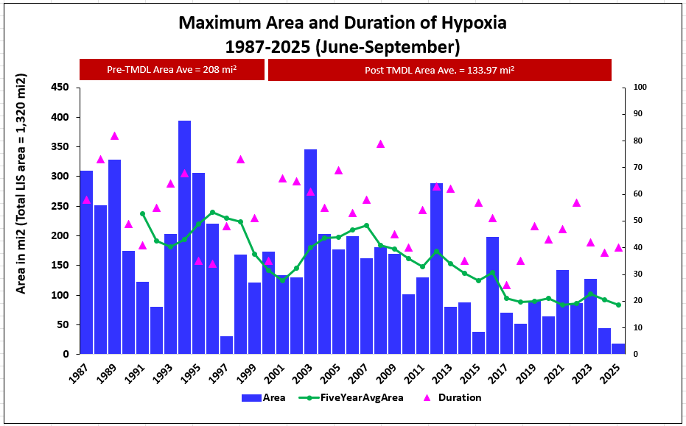
Long Island Sound Water Quality Monitoring Program
2025 Hypoxia Season Quick Facts

